Slide 1



Ajina attacks Central Asia:
Story of an Uzbek Android Pandemic
Anvar Anarkulov
Cyber Fraud Analyst at Group-IB

Slide 2
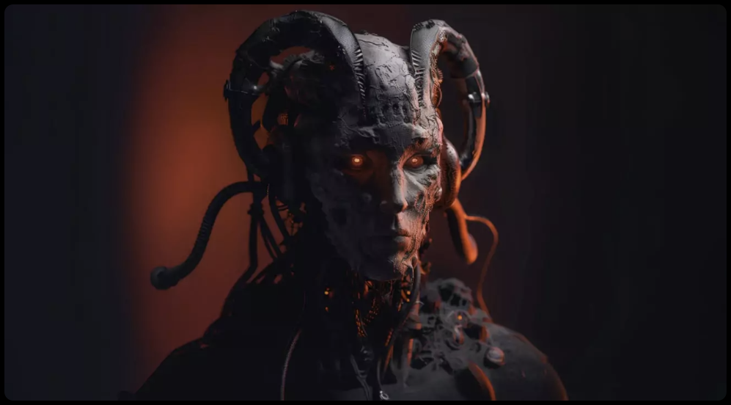
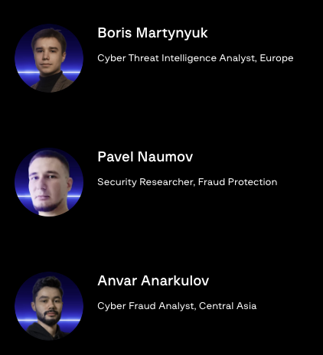
Ajina
Authors:
Discovered by Group-IB in May 2024, the Ajina.Banker malware is a major cyber threat in the Central Asia region, disguising itself as legitimate apps to steal banking information and intercept 2FA messages.

Slide 3
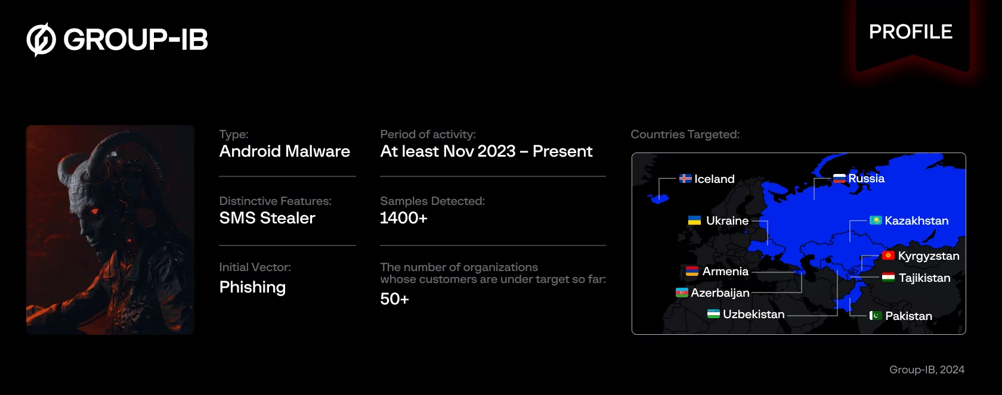
Threat Actor Profile

Slide 4
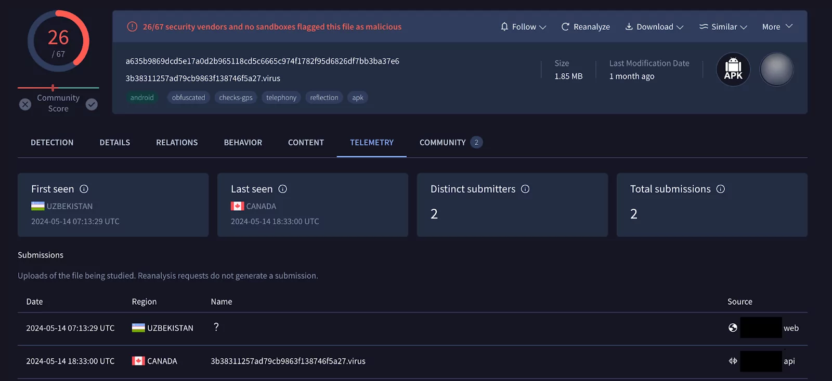
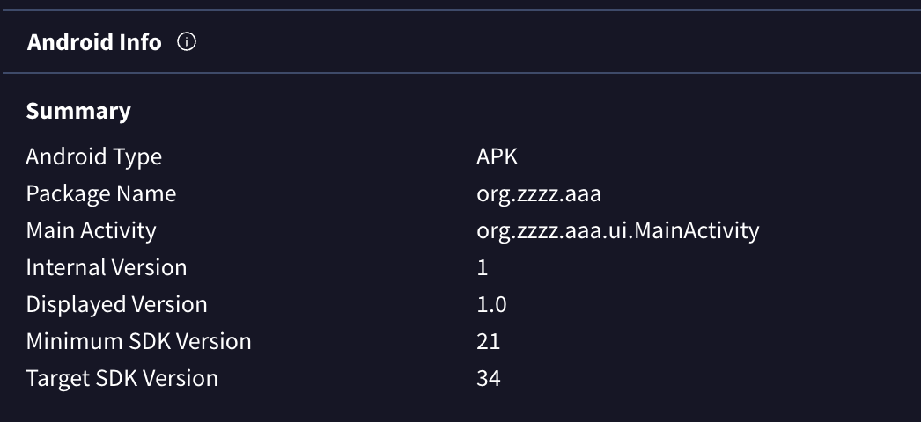
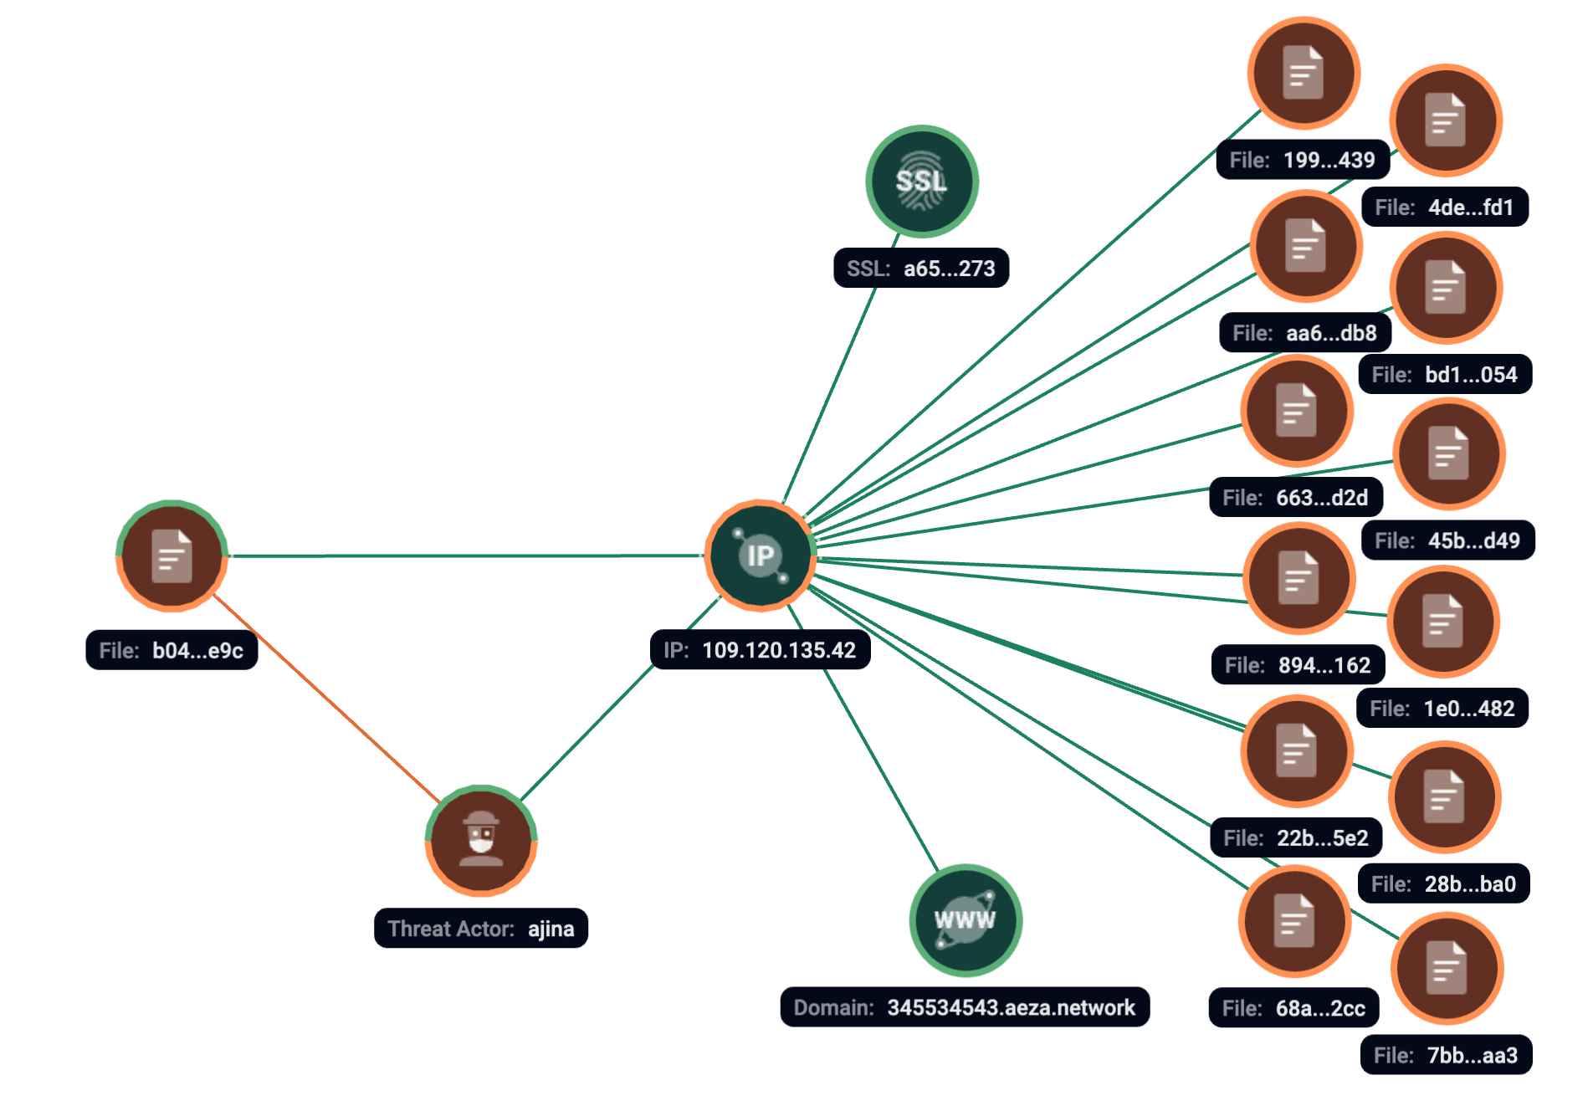
The starting point of the research
As part of its continuous monitoring and hunting procedures, Group-IB analysts discovered a malicious Android sample (SHA1 b04d7fa82e762ea9223fe258fcf036245b9e0e9c) that was uploaded to the VirusTotal platform from Uzbekistan via a web interface, and had an icon of a local tax authority app.

Slide 5
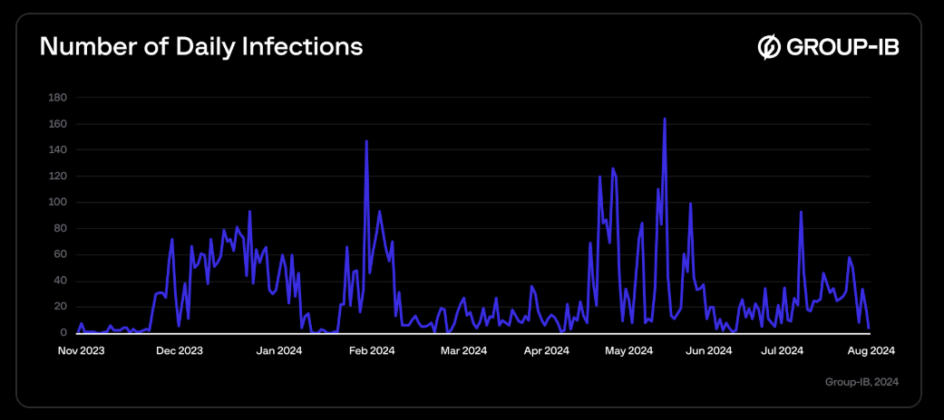
Timeline
The timeline above illustrates the daily count of new infections, indicating a persistent and ongoing threat. This trend reveals that many users continually fall victim to the malware, leading to a steady increase in infections over time. The data shows that the adversary’s distribution techniques remain effective, successfully targeting new victims daily.

Slide 6
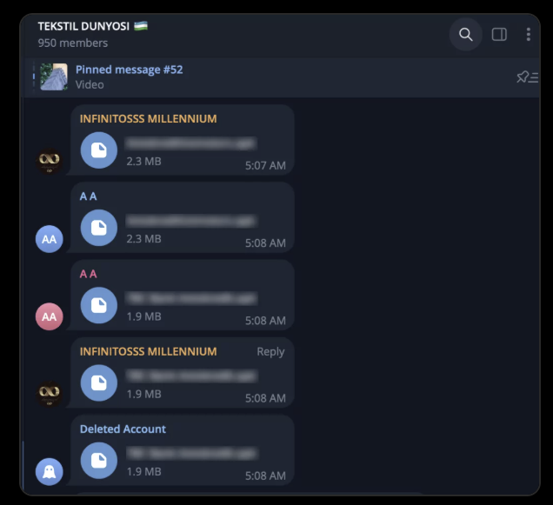
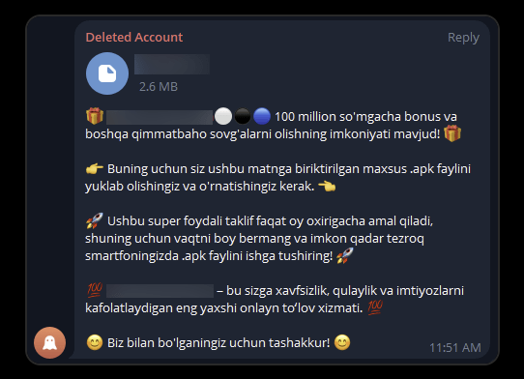
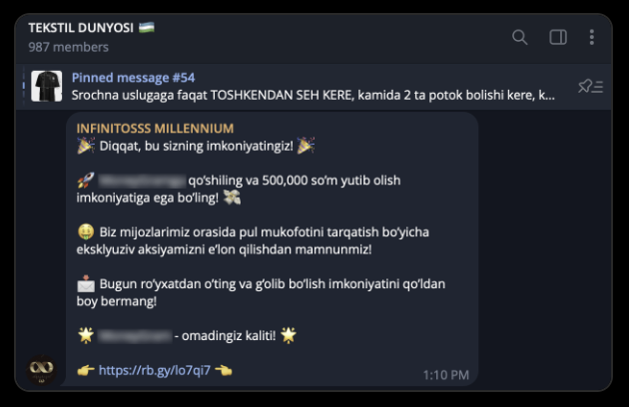
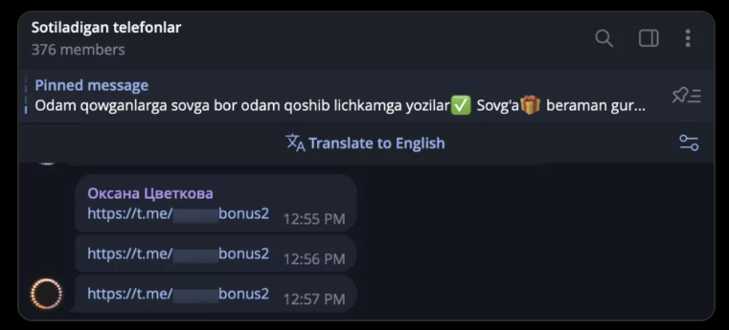
Malware distribution
Files with themes
File spamming
Link to
web-resource
Link to Telegram channel

Slide 7
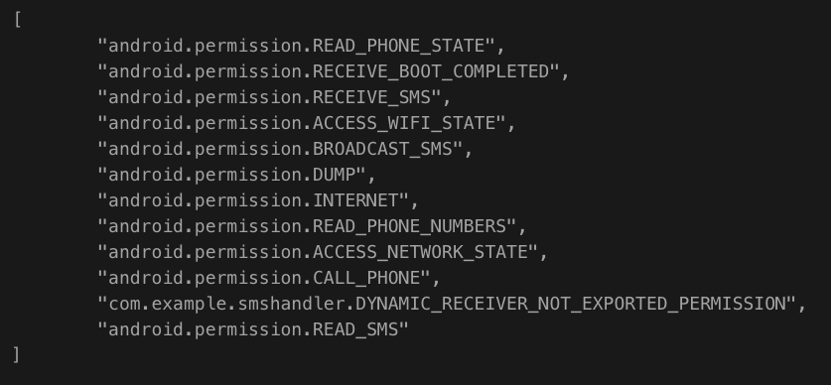
Malware analysis
Fraud Protection telemetry found 1,402 packages with package names com.example.smshandler (187 samples) and org.zzzz.aaa (1,215 samples) between 30 November 2023 and 31 July 2024 across 5,197 devices. Analyzed samples share a common code structure and subset of permissions that are requested.
The first known infection occurred on 30 November 2023 via package name com.example.smshandler (SHA1 cc6af149f1da110a570241dde6e3cfd0852cb0d8) with permission list:

Slide 8
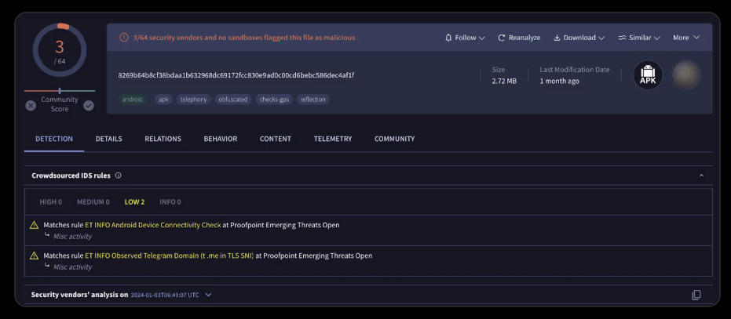
Ajina.Banker.A
According to Fraud Protection telemetry data, the first known sample of this malware uploaded to VirusTotal is “com.example.smshandler” (SHA1 84af2ce3a2e58cc8a70d4cc95916cbfe15f2169e). It was uploaded to the VirusTotal platform in January 2024, providing the initial glimpse into this malicious campaign.

Slide 9
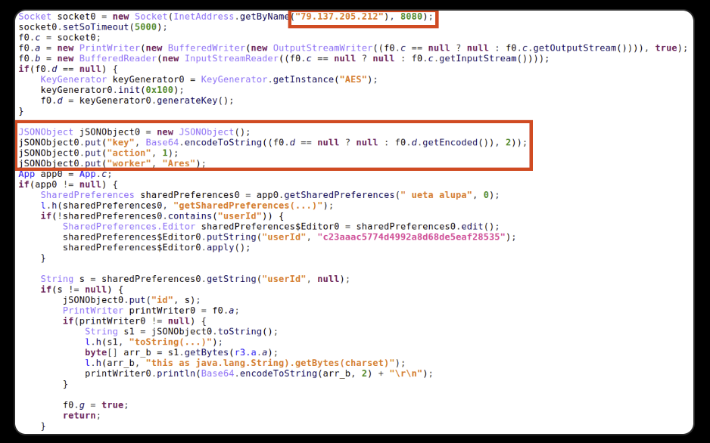
Ajina.Banker.A
Once the trojan is launched it connects to the gate server 79[.]137[.]205[.]212:8080, generates AES encryption key, and sends it to the gate server along with a hard-coded worker’s name and userId that is also stored into SharedPreferences.

Slide 10
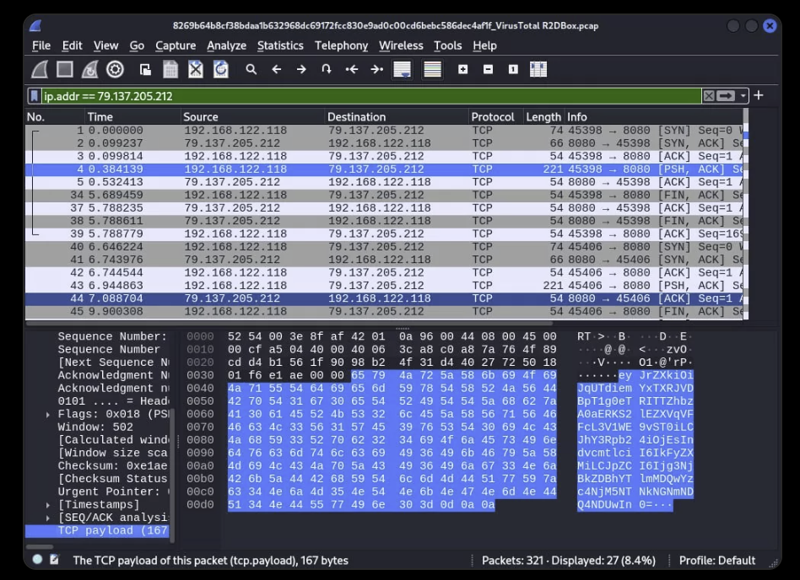
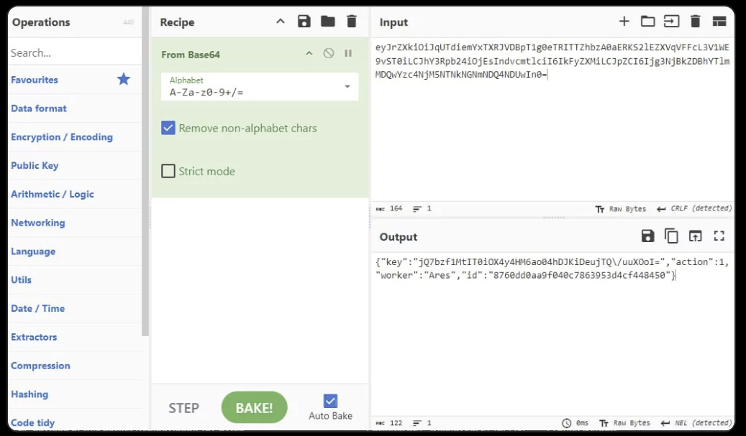
Ajina.Banker.A
Base-64 encoded string sent to server
Decoded payload

Slide 11
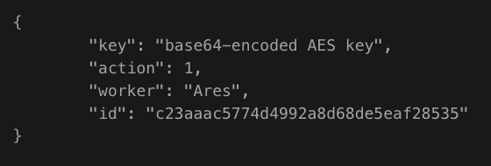
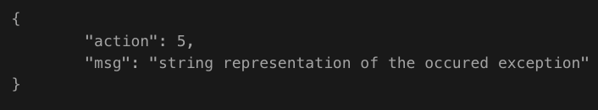
Ajina.Banker.A
This message is base64-encoded JSON:
Further research shows that messages are JSON-encoded, but are sent via raw TCP socket, not wrapped in HTTP. The general structure of messages contains a numeric action field with action type and other fields with arbitrary data depending on the action type. For example, if something goes wrong, the trojan sends a message to the gate server with the following structure:
All messages except action 1 are encrypted with AES/GCM/NoPadding cipher suite.

Slide 12
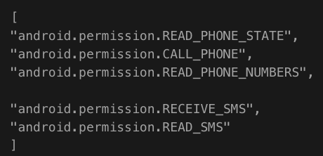
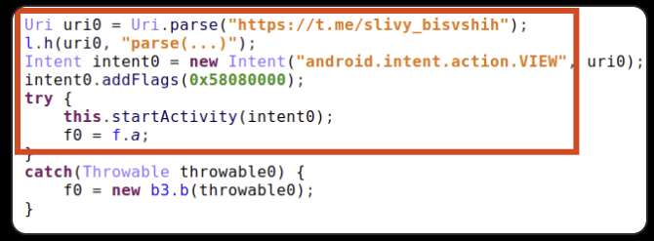
Ajina.Banker.A
From the victim’s point of view, once the trojan is initiated, it loads a background image from an external legit resource and requests the user to grant these permissions:
If permissions are granted via system dialog, the trojan disables the activity thus prevents launching an application UI again from the OS launcher.
If the user grants permissions via their mobile device’s operating system settings menu, the trojan then launches an intent that activates a third-party application related to trojan’s legend:
If permissions are not granted, the trojan sends a notification to the gate server (action 6).

Slide 13
Ajina.Banker.A
When permissions are granted, the trojan collects information from the infected device and sends it to the gate server (action 3). The following is the list of information collected:
list of installed financial applications originated from Armenia, Azerbaijan, Iceland, Kazakhstan, Kyrgyzstan, Pakistan, Russia, Uzbekistan and some international ones
sent SMS
for each active SIM card
MCC+MNC codes of current registered operator
Name of the current registered operator
ISO-3166-1 alpha-2 country code equivalent of the MCC (Mobile Country Code) of the current registered operator or the cell nearby
ISO-3166-1 alpha-2 country code equivalent for the SIM provider’s country code
MCC+MNC codes of the provider of the SIM
Service Provider Name (SPN)
Phone number
Is SPN “known” or not
Recipient
Body
Date
received SMS
Sender
Body
Date

Slide 14
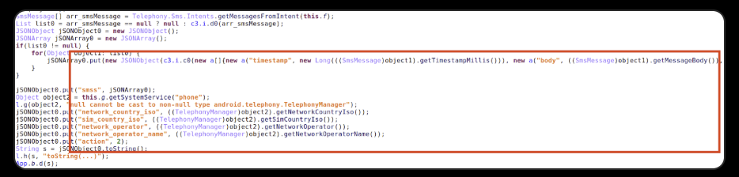
Ajina.Banker.A
The trojan abuses the <queries> element in the app’s manifest instead of abusing QUERY_ALL_PACKAGES permission, and therefore it can get information only about what is declared in manifest packages. However, it does not prevent the expansion of the list of targets for a particular sample because Trojan will send to the gate server every incoming SMS, including for banks not included in the list of targets (action 2). This allows, for example, the initial registration of accounts in organizations that are not the target of the trojan.
Broadcast receiver for incoming SMSes

Slide 15
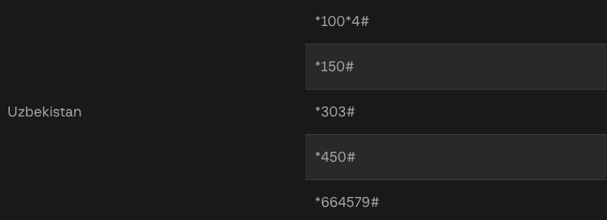
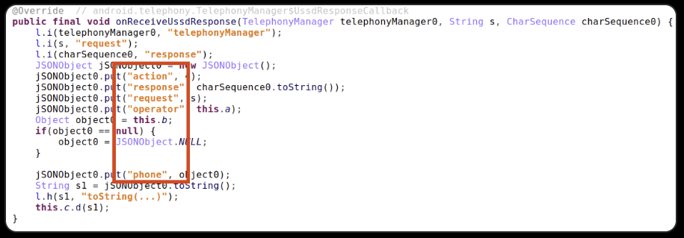
Ajina.Banker.A
While collecting SIM-card info, the trojan checks if the SPN is “known” and, if it is, sends an Unstructured Supplementary Service Data (USSD) request to get the phone number of the active SIM cards from the victim’s device.
After this USSD response is received, the trojan sends the response info to the gate server (action 4):
There is no difference between samples with com.example.smshandler package name from first and last infections with publicly available samples.

Slide 16
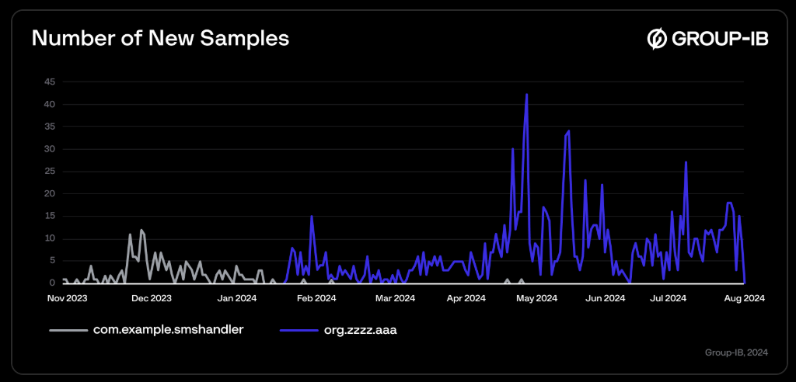
Ajina.Banker.B
We gathered several samples from the org.zzzz.aaa group and found little differences in the code structure. Further analysis of the appearance of new samples and code similarities lead us to the conclusion that this family is still under active development, and we can suggest that org.zzzz.aaa is the new version of the same family as com.example.smshandler.

Slide 17
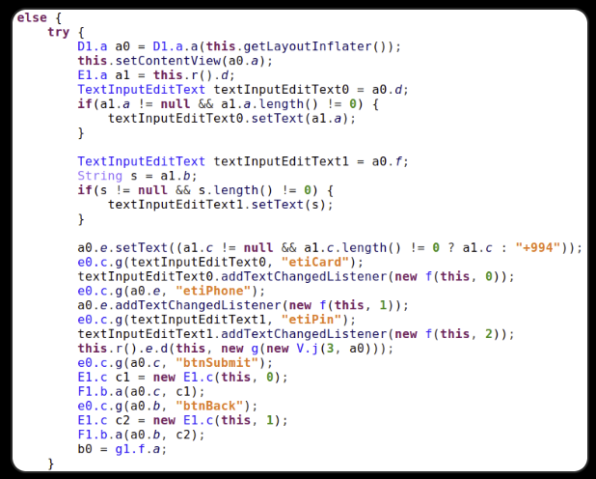
Ajina.Banker.B
As shown above, another group of samples has the org.zzzz.aaa package name. The first known infection occurred on February 18, 2024, while the earliest publicly available sample was detected on 20 February 2024 and is still the most downloaded for now.
One of the freshest samples has an interesting but less popular difference. It is a new execution flow branch showing another view instead of just a background image. Based on the names of variables of type TextInputEditText, we assume that this is something like a phishing page, but we are not able to trigger this branch.

Slide 18
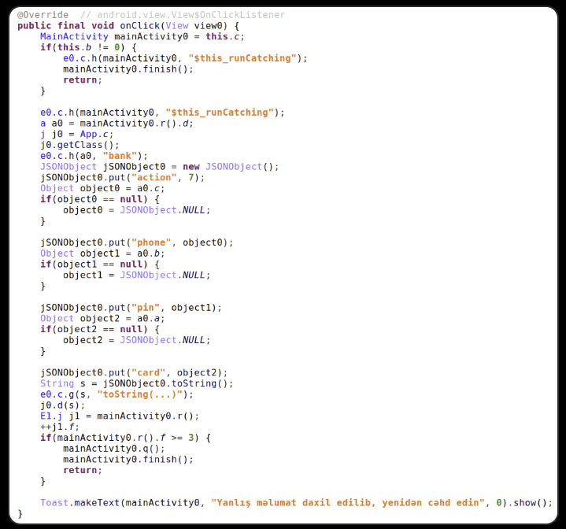
Ajina.Banker.B
Along with this new View there is a new action 7 message for sending user-provided phone number, bank card number and PIN-code.
It appears that this new feature is developed to primarily target users in Azerbaijan because of the hard-coded phone number prefix and text language on the Toast popup.

Slide 19
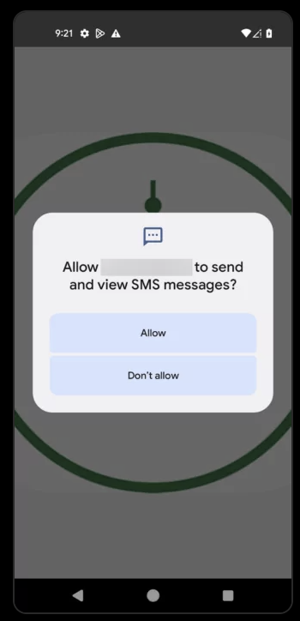
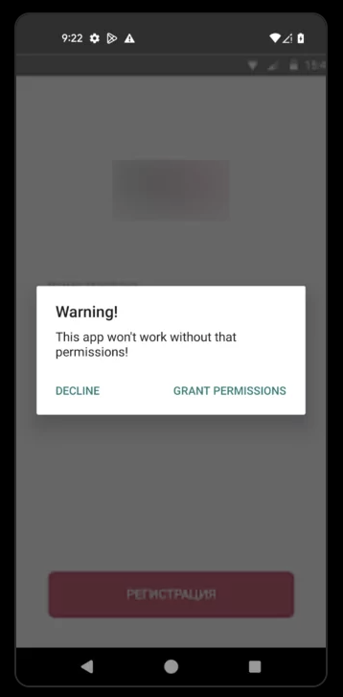
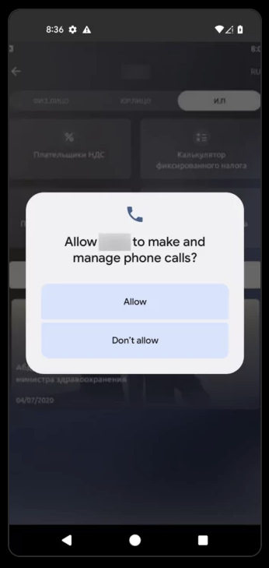
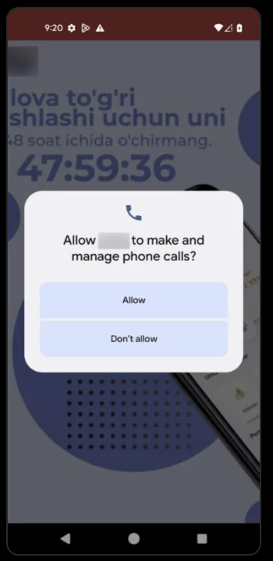
Ajina.Banker.B
There are several examples of layouts from discovered samples with various legends:

Slide 20
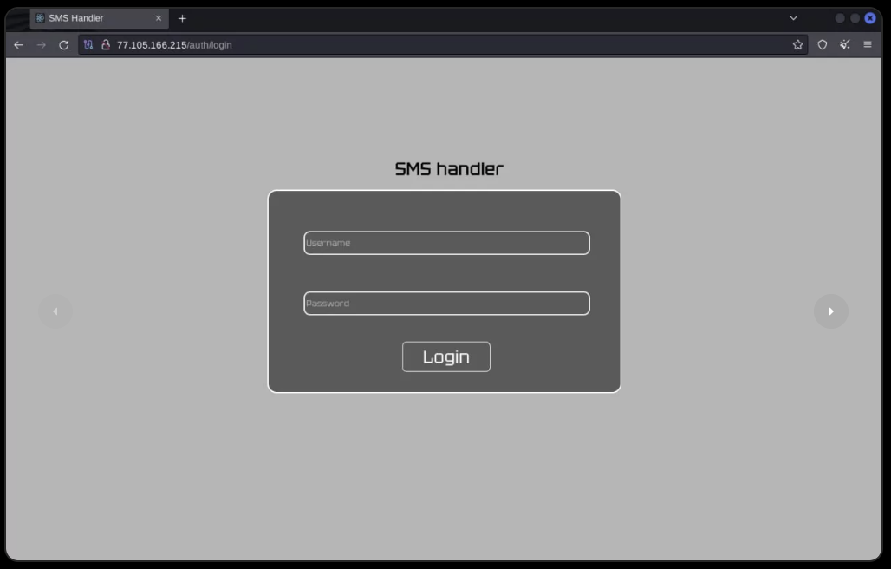
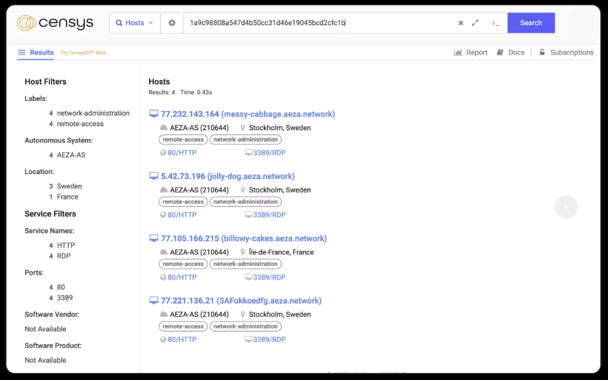
Infrastructure
We’ve managed to find a web panel of “SMS handler”, which refers us to the version of package name com.example.smshandler. It’s possible to find further servers by the same response, using search by body hash (SHA1 1a9c98808a547d4b50cc31d46e19045bcd2cfc1b).

Slide 21
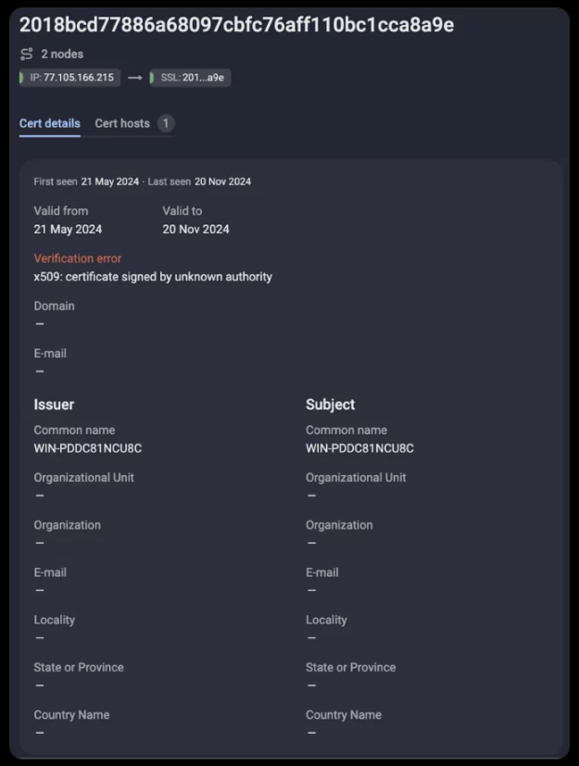
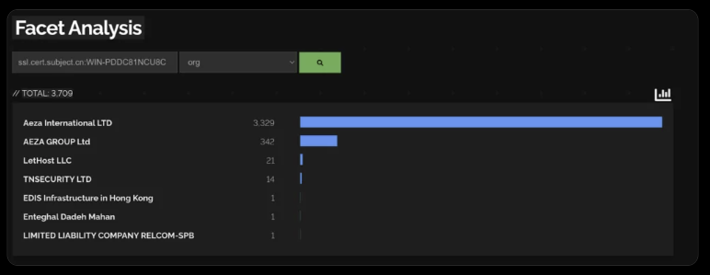
Infrastructure
On all of the adversary's servers we can find certificates with “WIN-PDDC81NCU8C” issuer and subject common name. However, this common name is generic and widely used by a specific hosting service according to Shodan.

Slide 22
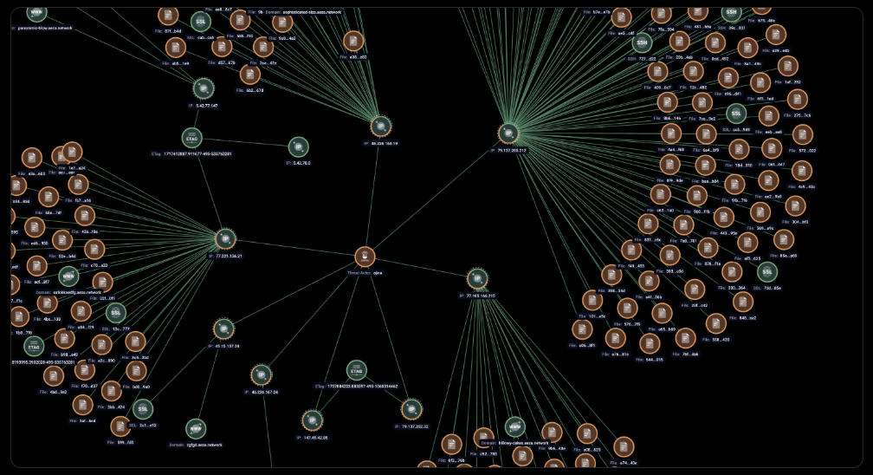
Infrastructure
We’ve seen 9 servers involved in this campaign, some of them shared the same Etags (e.g. 1718668565.8504026-495-535763281). Network infrastructure involved in this attack is shown on the graph analysis below.

Slide 23
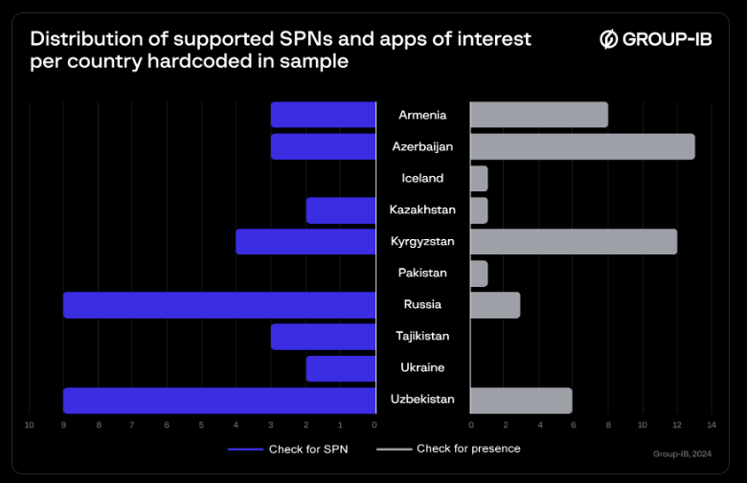
Targets
Distribution of supported SPNs and apps of interest per country hardcoded in sample

Slide 24
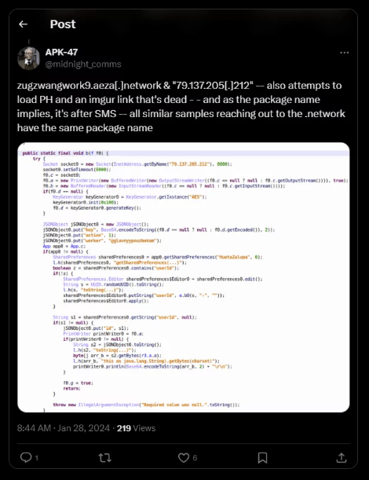
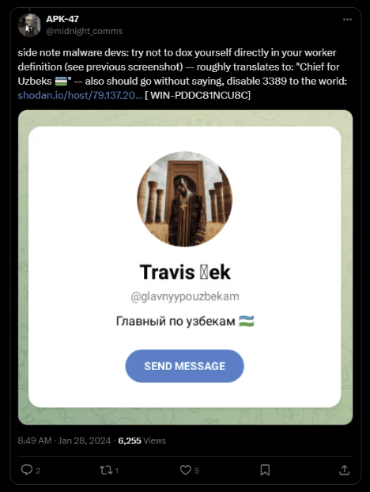
Attribution
The analysis of the malware has shown that the malicious files contain data about different affiliates. This leads us to conclude that it’s based on an affiliate programme, where the support for the initial project is led by a small group of people, and all the distribution and infection chains are made by affiliates working for the percentage.
Sample named “Вип Контент.apk” – “VIP Content.apk” in english – (SHA1 b4b9562a9f4851cba5761b1341f58f324f258123) was seen by MalwareHunterTeam and mentioned in Twitter post on January 28, 2024. One of the replies written to the post by APK–47 highlights an interesting username hardcoded as a name of one of the workers. The username “@glavnyypouzbekam” leads to the Telegram account named “Travis Bek” with description “Главный по узбекам” which means “Chief for Uzbeks”.

Slide 25
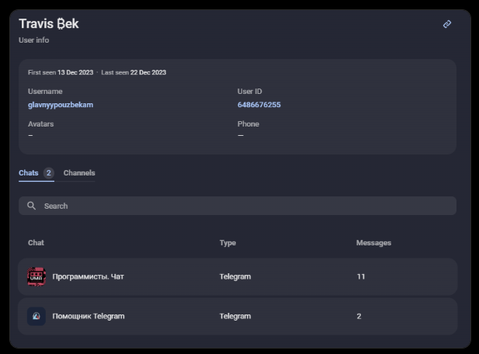
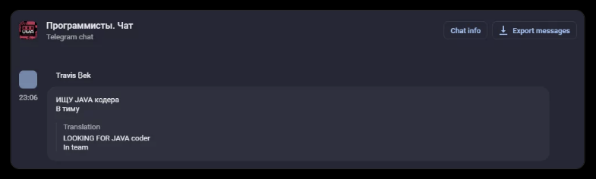
Attribution
Group-IB Threat Intelligence system has found the following activity related to the Telegram account mentioned. Adversary participated in programmer's chats, searched for “Java coder” and, according to his message, to an existing team. Detected user activity is shown on the figures below.

Slide 26
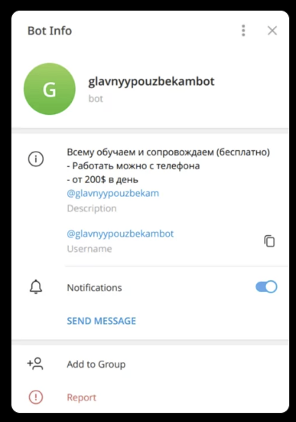
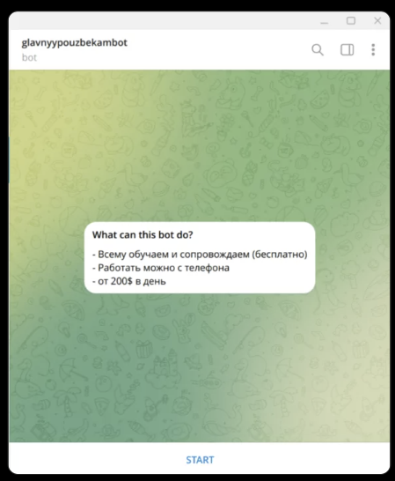
Attribution
We’ve also found a Telegram bot connected to this campaign by username “@glavnyypouzbekam” contained in its description. Bot with the username “@glavnyypouzbekambot” has information about the possibility of earning money online and an invitation to join written in Russian.
We assume that highly likely due to its uniqueness, the hardcoded worker’s name “@glavnyypouzbekam” is connected to the discovered Telegram activity. Based on our findings, we assume that the adversary standing behind this account is one of the operators of the Ajina malicious campaign. The hiring of Java coders, created Telegram bot with the proposal of earning some money, also indicates that the tool is in the process of active development and has support of a network of affiliated employees. Worth noting, that soon after the adversary’s name was posted on Twitter, current Telegram account was deleted.

Slide 27
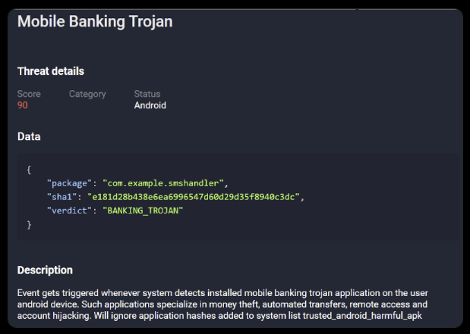
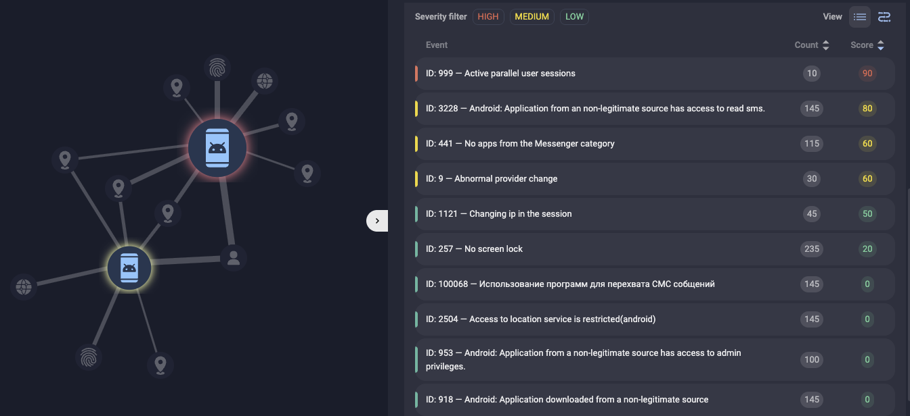
Prevention
To protect Group-IB customers from threats related to Ajina.Banker malware and other similar threats, Group-IB Fraud Protection uses events/rules to detect and prevent Ajina.Banker and other similar malware:
For confirmed malware samples Ajina.Banker:
When the malware is detected on the user’s device:
Group-IB’s Fraud Protection maintains an extensive database of all detected malware. When our system detects applications from the list of mobile Trojans downloaded to an end-user's device, we trigger the appropriate events to notify our customers promptly.
Once the trojan is successful, sensitive customer data typically falls into the hands of the threat actor, who then seeks to monetize this data. Often, the threat actor or their software will log into the stolen account. In such cases, a new device may appear when accessing the user account. Consequently, a rule has been developed to monitor accounts where a mobile banking trojan has been confirmed and to detect logins from new devices.

Slide 28
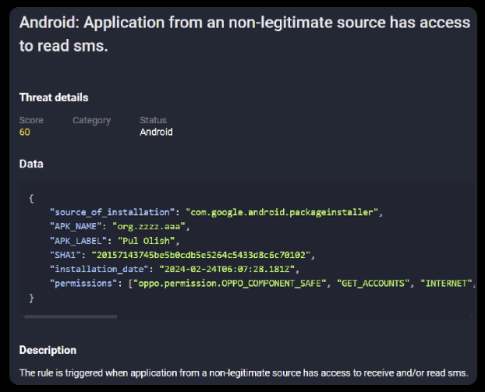
Prevention
When new versions of a given Trojan family appear:
For cases where the malware has not yet been added to the malware database, a new rule has been developed that focuses on the trojan’s specific characteristics. We check the characteristics of all software from a non-legitimate source for the ability to read SMS. These alerts are also transmitted to banks in the form of specific event types, increasing the likelihood of preventing fraudulent transactions by threats.

Slide 29
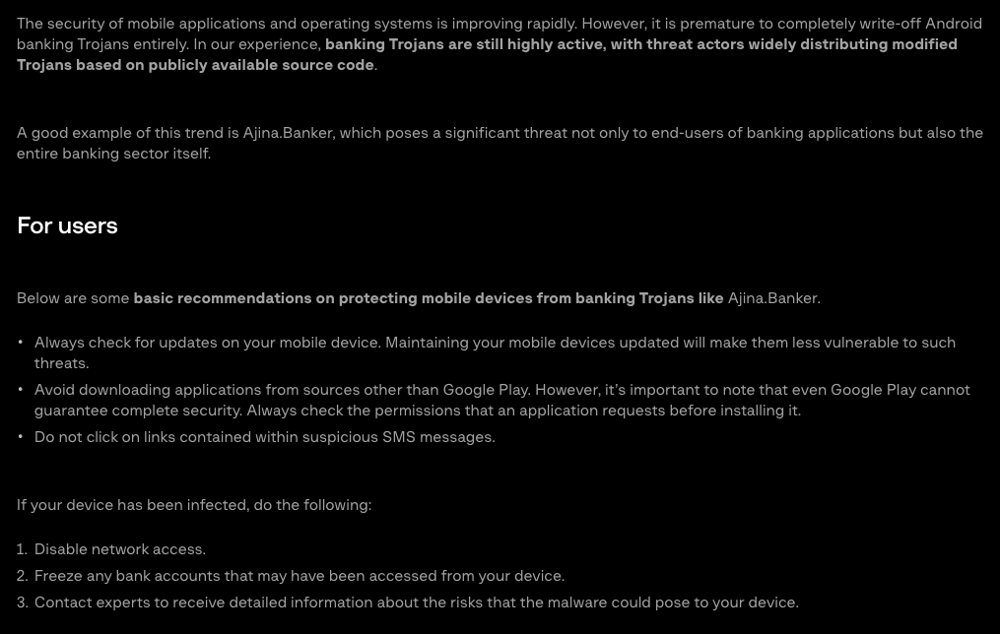
Recommendation

Slide 30
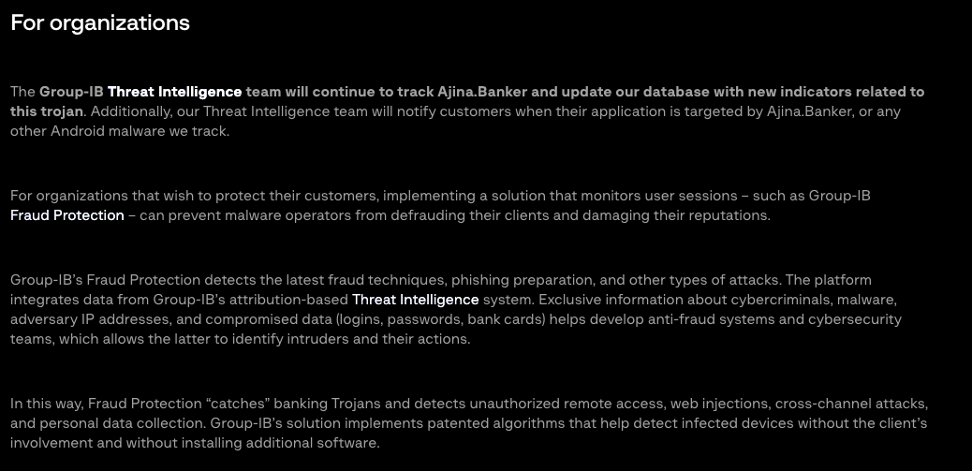
Recommendation

